Slide 1
Advantage

Slide 2




Advantage
Manage medical record
Nguyễn Trung Nam

Slide 3
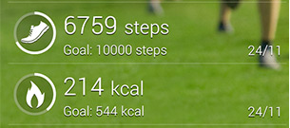
Advantage
Tracking patient’s practice data

Slide 4

Advantage
Support doctor make food ingredient, prescription.

Slide 5
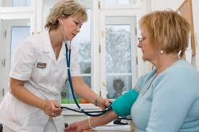
Main Function
Register examination

Slide 6
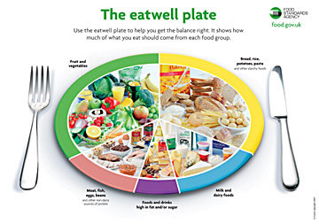
Main Function
Make food ingredient by meal

Slide 7

Main Function
Suggest treatment

Slide 8
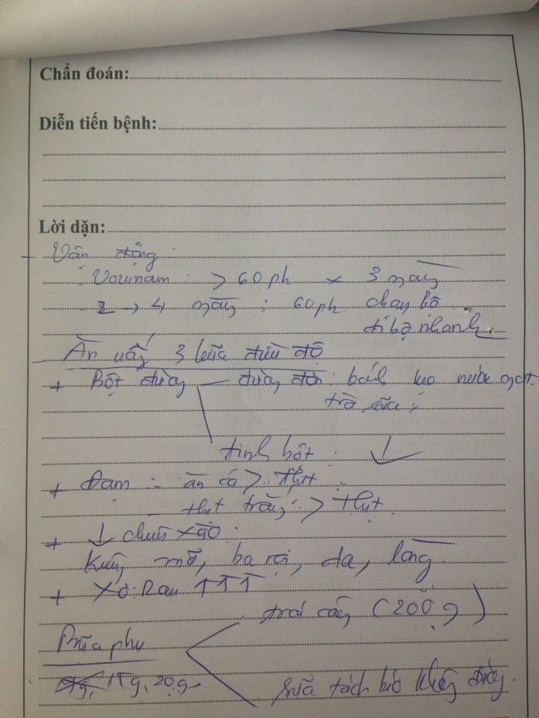
Main Function
Make prescription

Slide 9
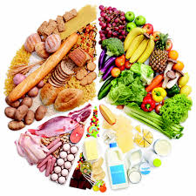

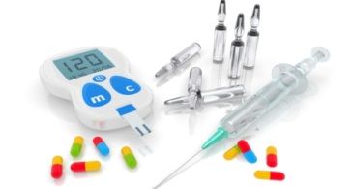

Main Function
Remind patient in treating

Slide 10
Main Function
Get patient’s practice data

Slide 11


Scope of System
Treating with patient 20 – 60 ages.

Slide 12

Scope of System
System doesn’t support patient make appointment with doctor.
Setup meeting

